Slide 1
DIABETES PREDICTION
USING LOGISTIC REGRESSION
By Group 4
Kaggle.com/uciml/pima-Indians-diabetes-database/kernel

Slide 2
Problem Statement
The death rate of women was high this year due to late diagnosis of diabetes by the women.
This project is to ensure they know early and start medications.

Slide 3
The objective of this project is to predict whether or not a patient has diabetes, based on certain diagnostic measurements included in the dataset.
All patients are females and are at least 21 years old of Pima Indian heritage.

Slide 4
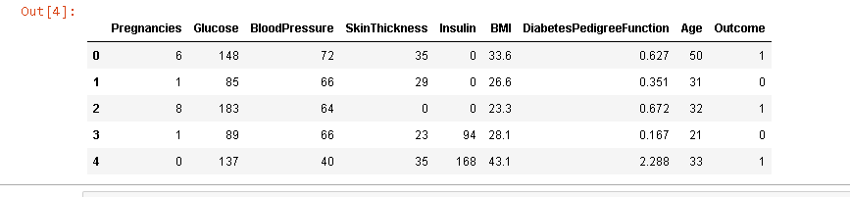
The datasets consists of several medical predictor variables and one target variable −Outcome. Predictor variables includes the number of pregnancies the patient has had, their BMI, insulin level, age, and so on.

Slide 5
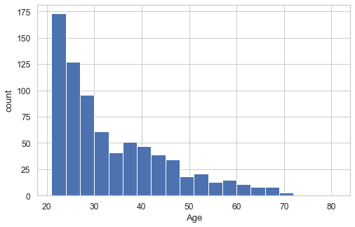
Age Distribution

Slide 6
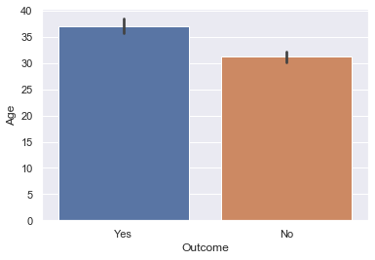
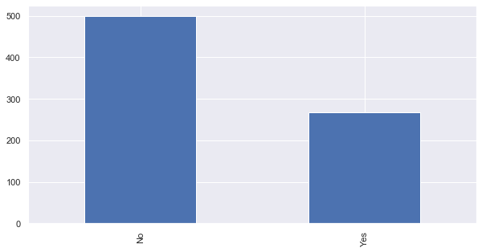
Bar Chart showing Diabetic patients and Non Diabetic Patients
Number of Females
Outcome

Slide 7
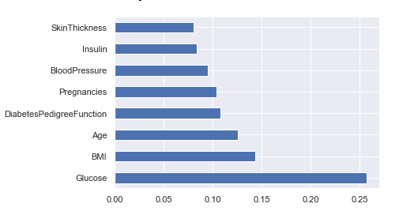
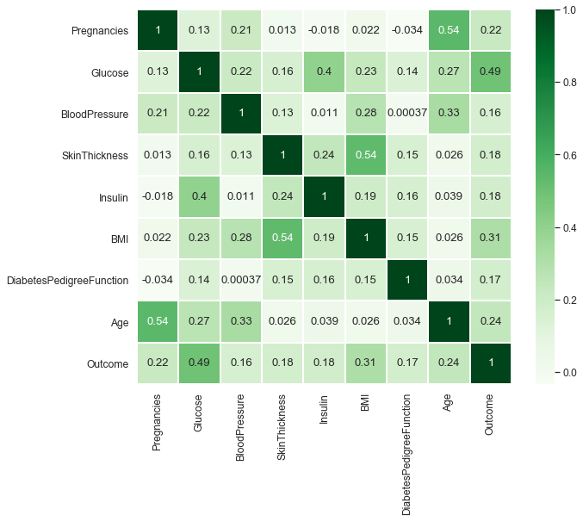
Charts showing the level of importance of the diagnostic measurements (Variables)

Slide 8
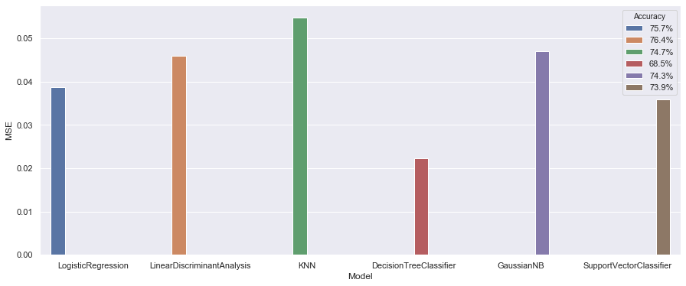
Bar chart showing the relationship between Models, Accuracy and Mean Squared Error

Slide 9
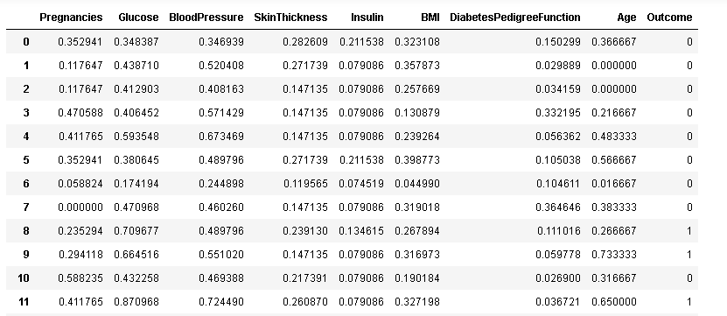

Slide 10
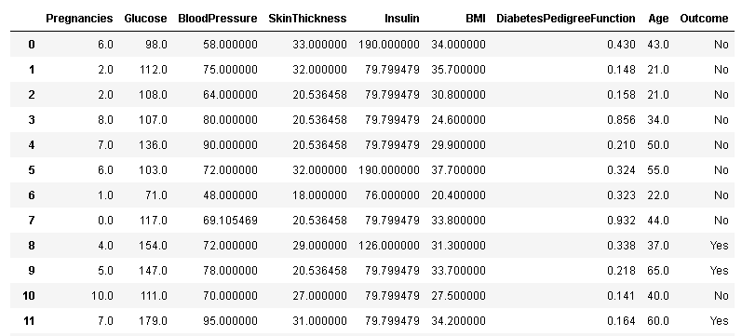
Yes – Diabetic Patient
No – No Diabetics

Slide 11
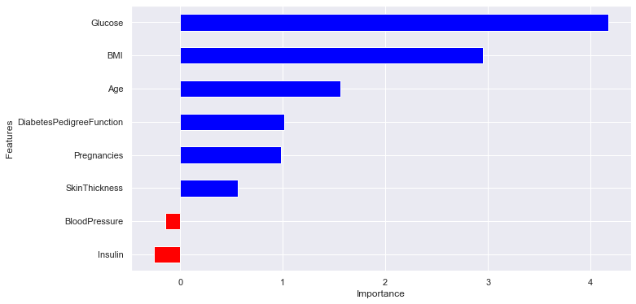
Conclusion
Glucose level and BMI have significant influence on the model
Blood pressure and Insulin has a negative influence on the prediction, i.e. higher blood pressure is correlated with a person not being diabetic.

Slide 12
Recommendations
Regular fitness exercise
Good level of nutrition in the right proportion
Lots of water intake for a balanced Body Mass Index(BMI) and minimal weight gain

